Slide 1
August 12, 2019 UNAVCO Short Course Long Form Lecture Notes
Principles and Theory of
Radar Interferometry
Paul A Rosen
Jet Propulsion Laboratory

Slide 2
Acknowledgments
Materials compiled and modified from presentations shared among a number of colleagues over the years
Scott Hensley
Tony Freeman
Jakob van Zyl
Piyush Agram
Howard Zebker

Slide 3
Motivation – Understanding the processes and phenomenology of radar interferometry
Notes:
Important to understand the methods and reasons why we can go from an apparently random and bland collection of energy from a radar and form images that convey backscatter information and encode phase signatures as well, and how these images can be combined to form

Slide 4
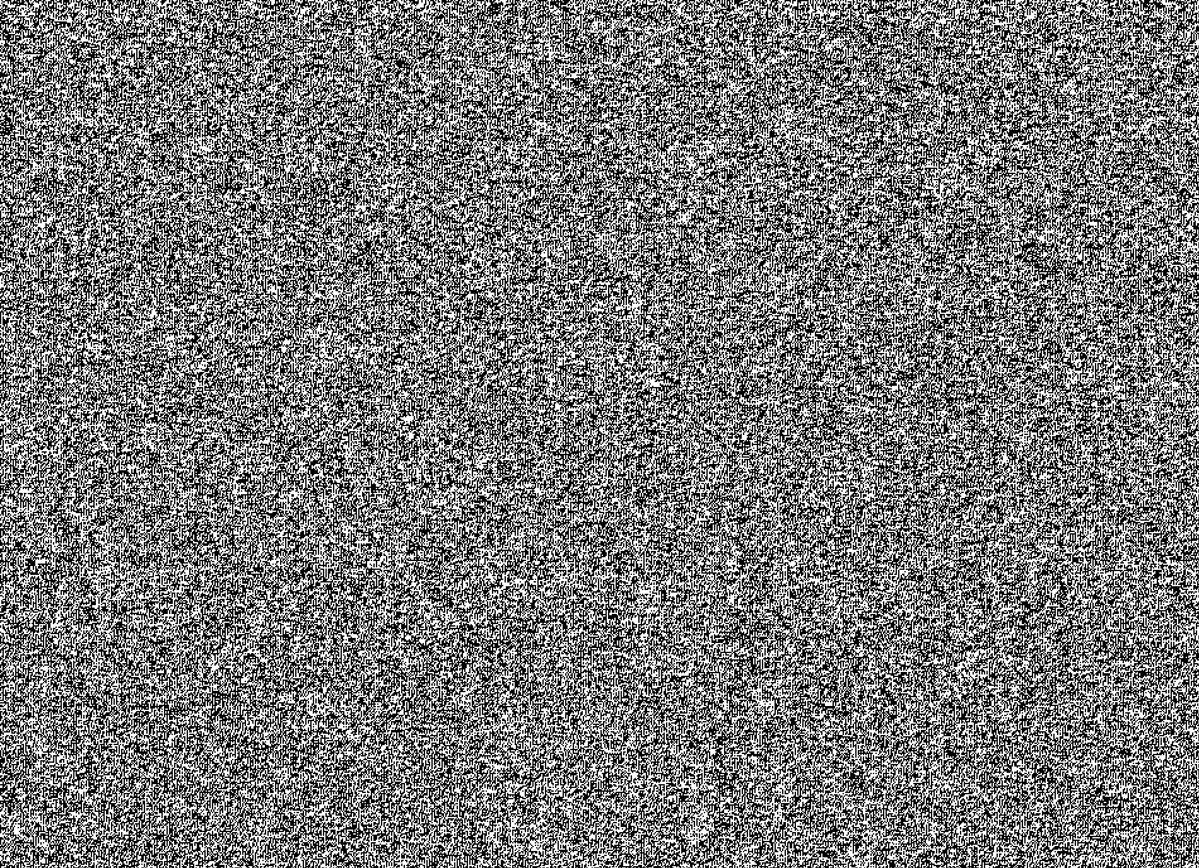
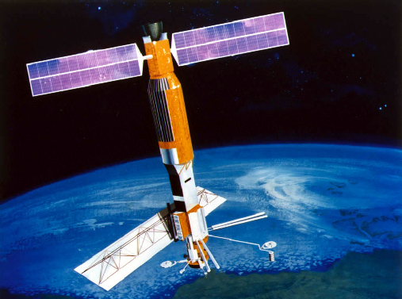
Motivation – Understanding the processes and phenomenology of radar interferometry
Satellite Observation
First Time
Notes:
Important to understand the methods and reasons why we can go from an apparently random and bland collection of energy from a radar and form images that convey backscatter information and encode phase signatures as well, and how these images can be combined to form

Slide 5
Motivation – Understanding the processes and phenomenology of radar interferometry
Satellite Observation
Amplitude
First Time
Next Time
Notes:
Important to understand the methods and reasons why we can go from an apparently random and bland collection of energy from a radar and form images that convey backscatter information and encode phase signatures as well, and how these images can be combined to form

Slide 6
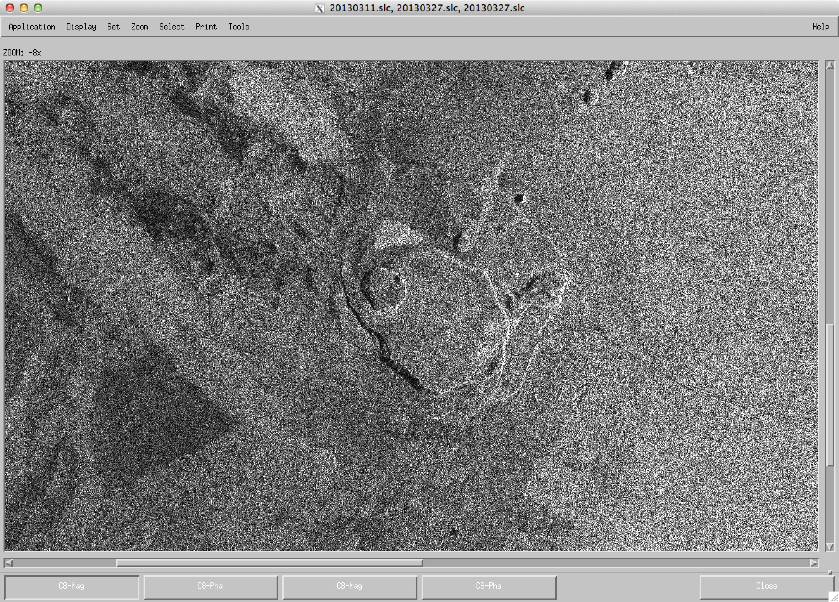
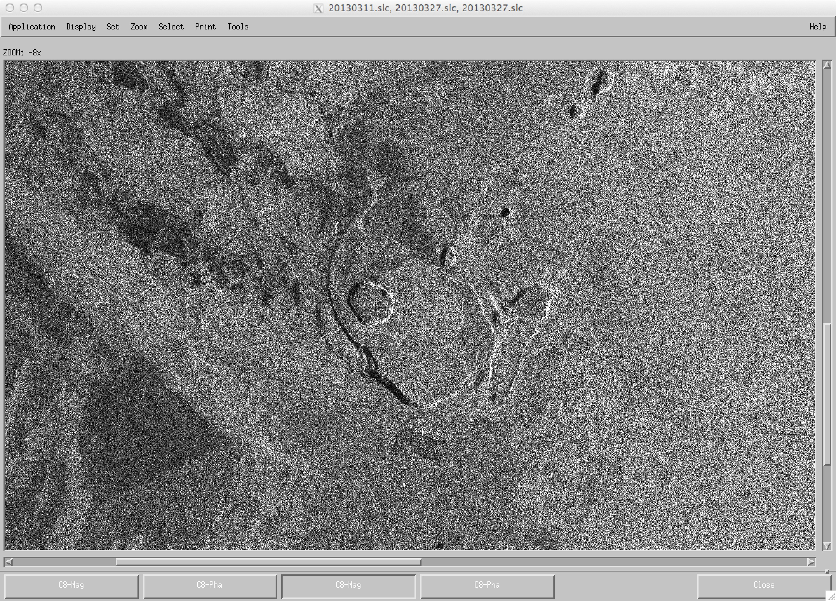
Motivation – Understanding the processes and phenomenology of radar interferometry
Satellite Observation
Magic of imaging
Amplitude
First Time
Next Time
Notes:
Important to understand the methods and reasons why we can go from an apparently random and bland collection of energy from a radar and form images that convey backscatter information and encode phase signatures as well, and how these images can be combined to form

Slide 7
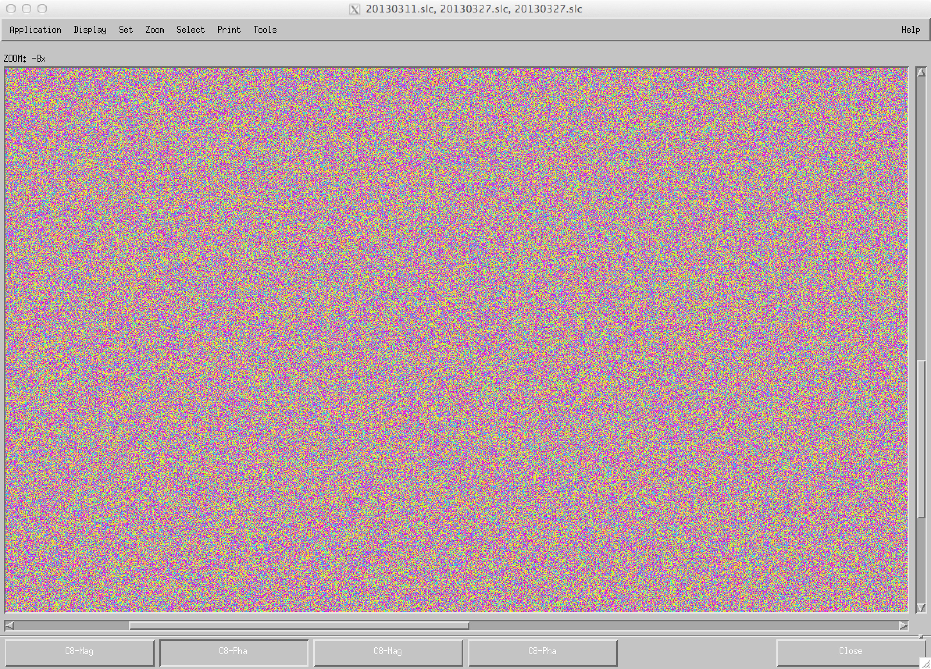
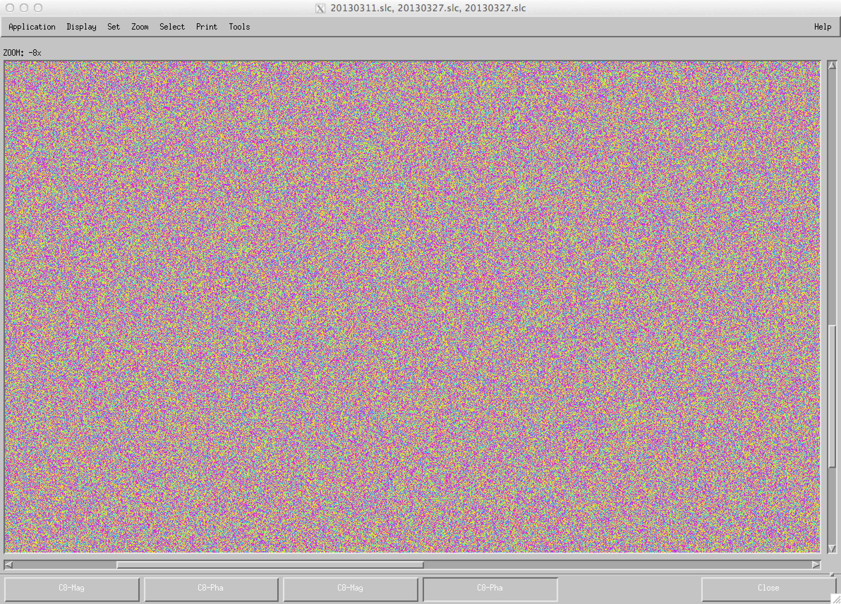
Motivation – Understanding the processes and phenomenology of radar interferometry
Satellite Observation
Magic of imaging
Phase
Amplitude
First Time
Next Time
Notes:
Important to understand the methods and reasons why we can go from an apparently random and bland collection of energy from a radar and form images that convey backscatter information and encode phase signatures as well, and how these images can be combined to form

Slide 8
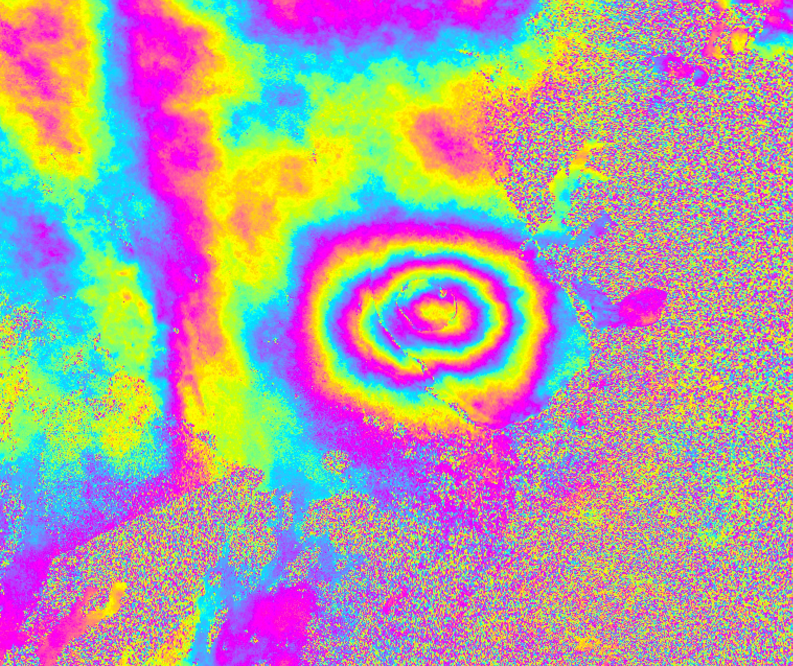
Motivation – Understanding the processes and phenomenology of radar interferometry
Satellite Observation
Magic of imaging
Phase
Amplitude
First Time
Magic of interferometry
Next Time
Notes:
Important to understand the methods and reasons why we can go from an apparently random and bland collection of energy from a radar and form images that convey backscatter information and encode phase signatures as well, and how these images can be combined to form

Slide 9
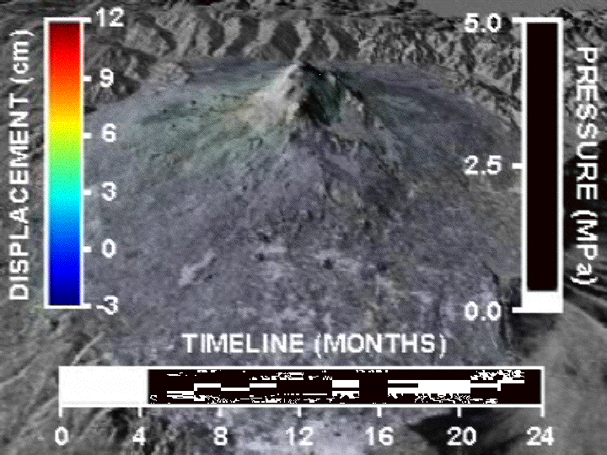
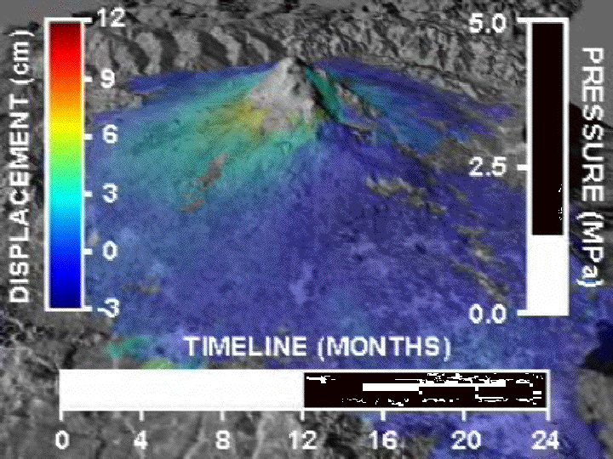
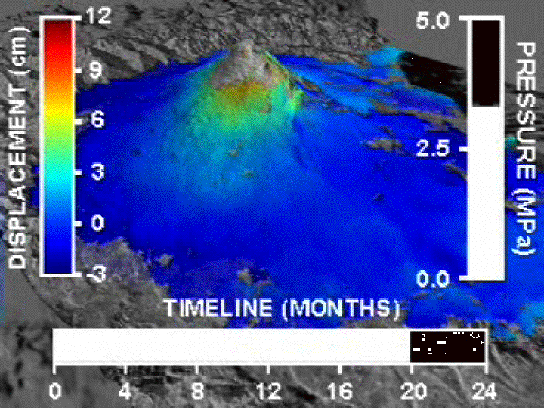
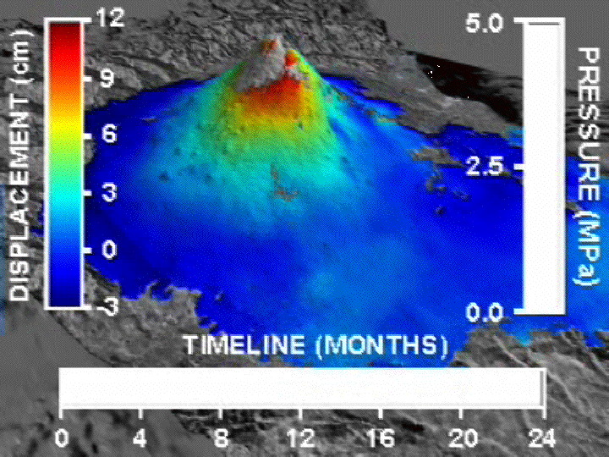
Motivation – Understanding the processes and phenomenology of radar interferometry
Satellite Observation
Magic of imaging
Phase
Amplitude
Modeling
First Time
Magic of interferometry
Next Time
Notes:
Important to understand the methods and reasons why we can go from an apparently random and bland collection of energy from a radar and form images that convey backscatter information and encode phase signatures as well, and how these images can be combined to form

Slide 10
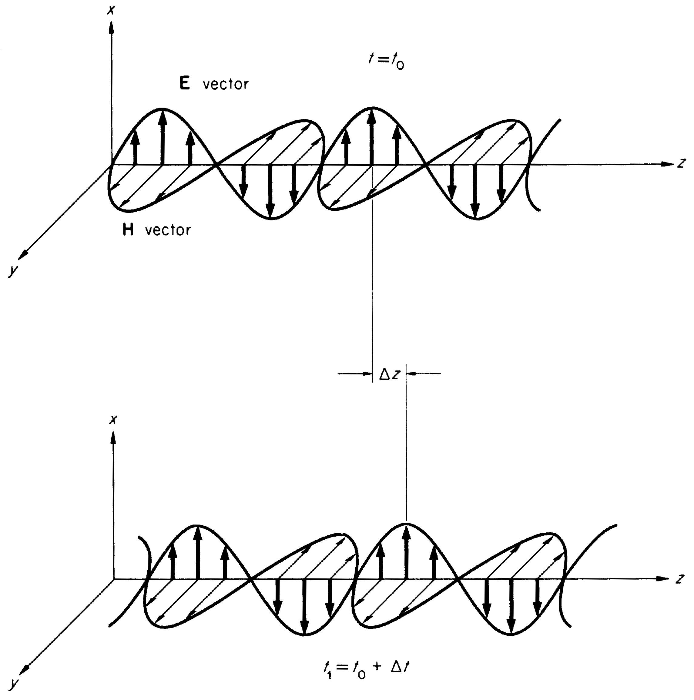
Wave Properties of Light
Radar waves, like lightwaves, are electromagnetic energy that propagates
“Plane wave” propagating in direction k
“Phase”
frequency
Energy propagates

Slide 11
Outline of Theory Sessions
Morning
I. Radar Imaging Fundamentals
Basic Principles of Radar and SAR
Properties of Radar Images
Afternoon
II. Geometric Aspects of Interferometry and Interferometric Phase
Topographic Mapping
Deformation Mapping
Phase Unwrapping and Atmosphere
III. Interferometric Correlation
SNR and Interferometric Correlation
Geometric, Temporal, Volumetric Decorrelation

Slide 12
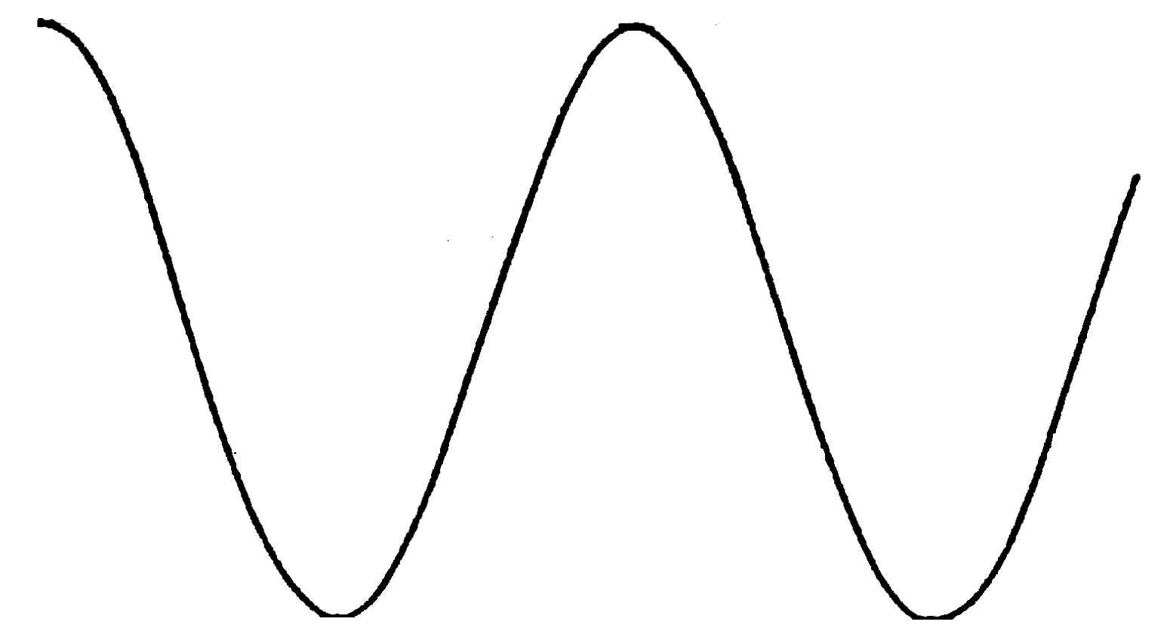
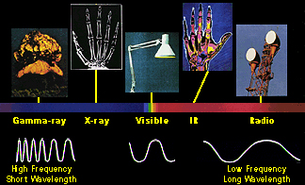
Radar and Light Waves
Millimeters to meters wavelength
Radars operate at microwave frequencies, an invisible part of the electromagnetic spectrum
Microwaves have wavelengths in the millimeter to meter range
Like lasers, radars are coherent; we can determine the signal’s phase
Position z
The Electromagnetic Spectrum
Phase
Common Radar Frequency Bands
Band | Ka | Ku | X | C | S | L | P
Wavelength (cm) | 1 | 2 | 3 | 6 | 12 | 24 | 75
Frequency (G-cycles/s) | 30 | 15 | 10 | 5 | 2.5 | 1.2 | 0.4
tiny
100’s μm
mm’s to m’s

Slide 13
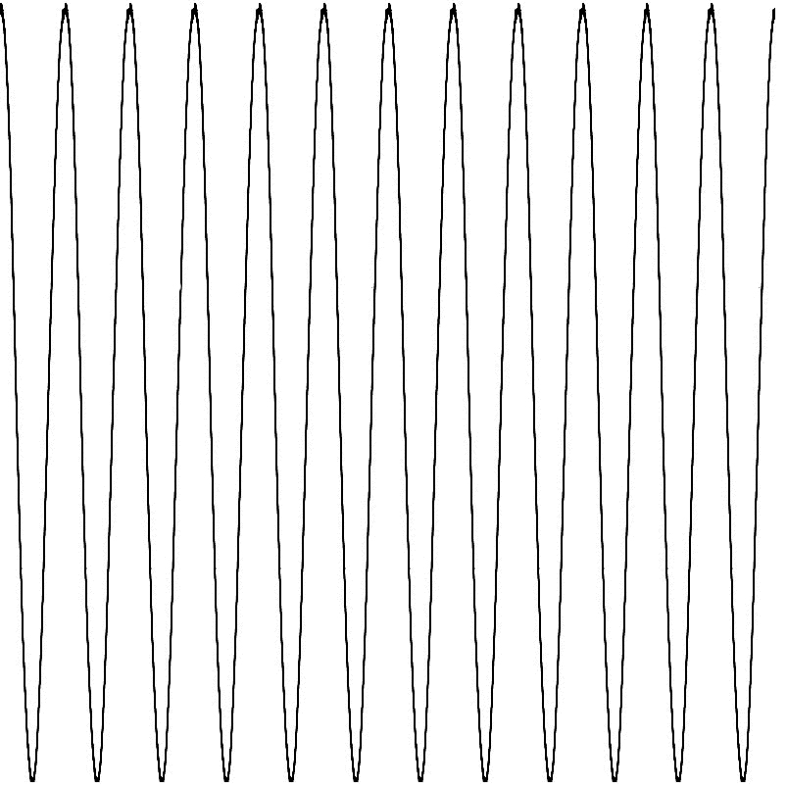
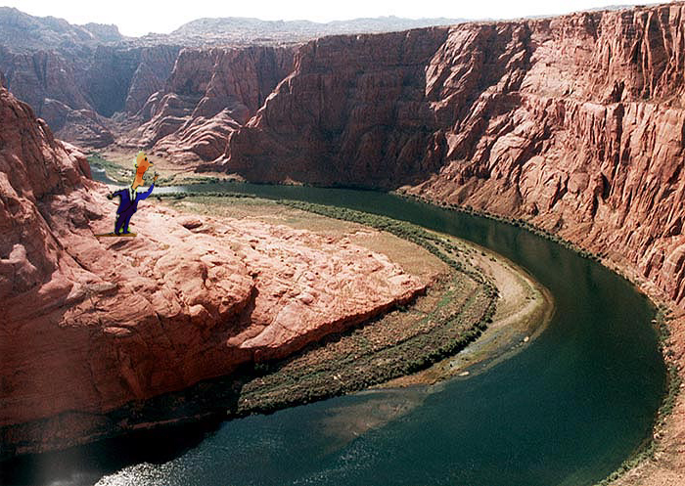
The Radar Concept
At light speed, c
Object scatters energy back to radar
Transmitter/
Receiver
Much like sound waves, radar waves carry information that echoes from distant objects
The time delay of the echo measures the distance to the object
The changes of the message in the echo determines the object characteristics
!!!olleH
!!!olleH
Hallo!!!
Halo!!

Slide 14
Achieving resolution in range
If possible, use a narrow pulse to resolve close targets

Slide 15
Achieving resolution in range
If pulse can’t be narrow, use a “chirped” signal
Matched filtering can recover smeared targets

Slide 16
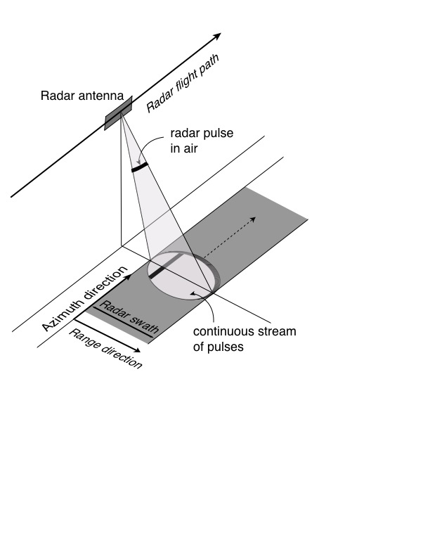
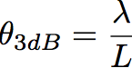
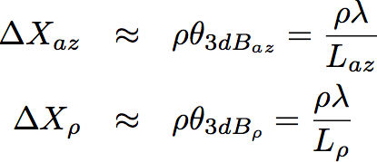
Radar on a Moving Platform
Small antenna -
big beam
Pulses are transmitted from the radar platform as it moves along its flight path
Each pulse has finite extent in time, illuminating a narrow strip of ground as it sweeps through the antenna beam
Some of the energy from the ground is scattered back to the radar instrument
Big antenna
-small beam
Antenna Beamwidth
Footprint Size on Ground

Slide 17
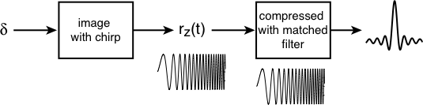
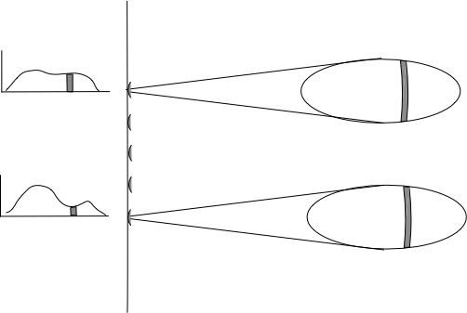
Matched Filtering of Received Echo
Point target
In general, the ground surface can be though of as a distribution of point targets, so the received echo, r(t), is a convolution of ground and chirp signal
Transmitted pulses are usually coded waveforms with significant bandwidth
Matched filtering allows recovery of fine resolution features with a low peak-power pulse train
Radar Top View

Slide 18
Radar Geometric Terminology
h_{p}
Local Surface Normal
S
= Look Angle
= Incidence Angle
ρ = Range θ_{bw} = beamwidth
S = Swath width
r_{e} = Radius of Earth
h_{p} = Height of platform

Slide 19
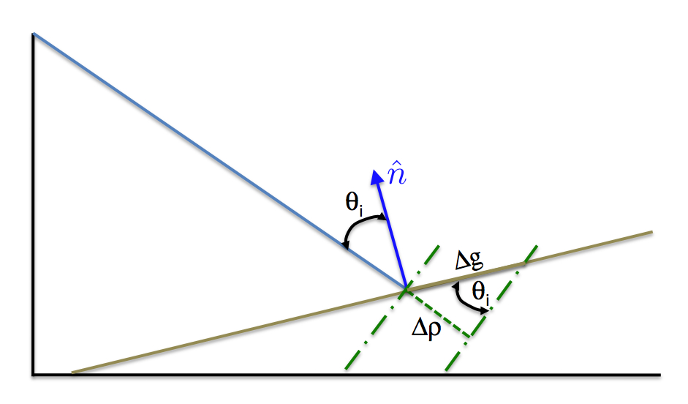
Ground Resolution
The ground resolution, Δg, depends on the range resolution and incidence angle, θ_{i}.
Incidence angle is the angle between the wave propagation direction or line-of-sight and the normal to the surface.

Slide 20

Raw Signal of a Point Target
Range
Pulse Number
This “image” shows a sequence of simulated pulse echoes from a single point target

Slide 21
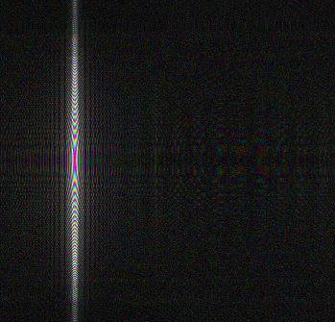
Range Compression of a Point Target; after Matched filtering
Range
Pulse Number
This “image” shows the simulated pulse echoes after range compression matched filtering

Slide 22
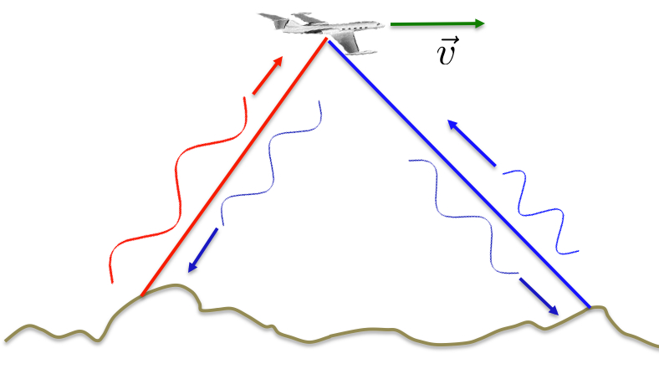
Doppler Shift
Objects moving relative to a radar experience a frequency shift called the Doppler shift.
Objects moving toward the radar have higher frequencies
Objects moving away from the radar have lower frequencies.

Slide 23
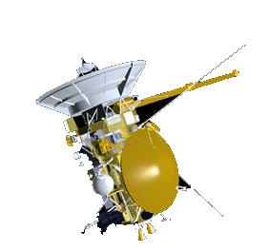
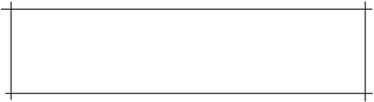
SAR Imaging Concept
Real Aperture Imaging
Synthetic Aperture Imaging
Cross-Track resolution
achieved by short or coded
pulses
Synthesized Long Antenna
Along-Track resolution limited by beamwidth
Along-Track resolution achieved by coherently combining echoes from multiple pulses along-track
• Resolution proportional to antenna length
• Independent of Range/Frequency
Real Along Track Beam
Synthesized Along Track Beam

Slide 24
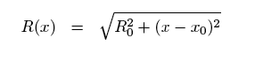
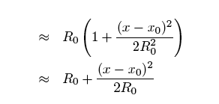
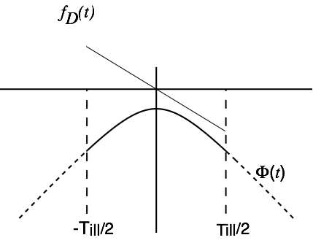
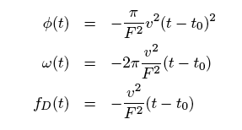
Doppler in SAR Imaging
t
Dropping the constant term

Slide 25
Frequency Domain View of SAR
Instantaneous frequency spread within an echo in azimuth is a function of the azimuth beamwidth.
FREQUENCY DOMAIN
f
Courtesy Scott Hensley

Slide 26
Nyquist Sampling Theorem
A consequence of the Nyquist Sampling Theorem is that the radar Pulse Repetition Frequency (PRF) must be twice the bandwidth of the received signal in order to avoid spectral aliasing of the signal.
Using the expression from the previous viewgraph for the azimuth bandwidth we have that
which for small squint angles, θ_{az} smaller than 25°, is often simplified to
Note that the required PRF is independent of wavelength and range and only depends on the platform velocity and the azimuth antenna dimension.
Courtesy Scott Hensley

Slide 27
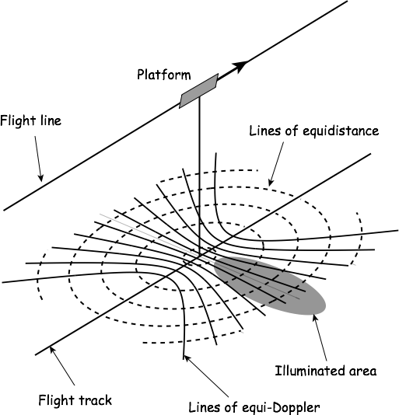
Range-Doppler Coordinates

Slide 28
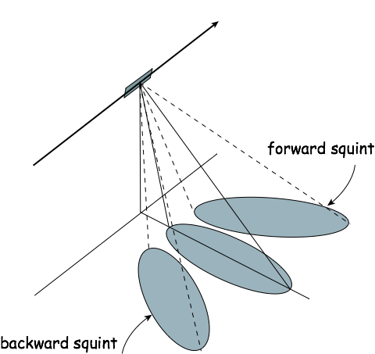
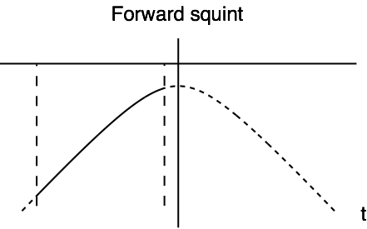
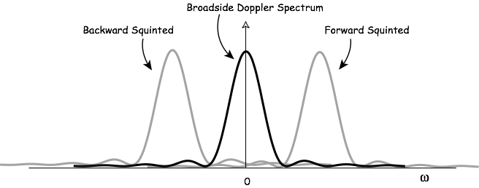
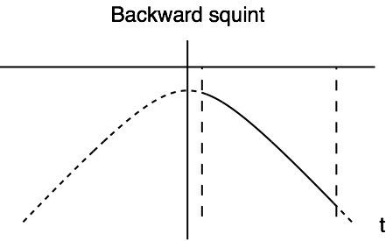
Doppler and Squint
28

Slide 29

Zero Doppler Processing
Zero Doppler Geometry is closer to planimetric grid
Forward Squinted
Backward Squinted
Zero Doppler Illuminated Area
Many prefer this output representation even if data is naturally forward or backward squinted

Slide 30
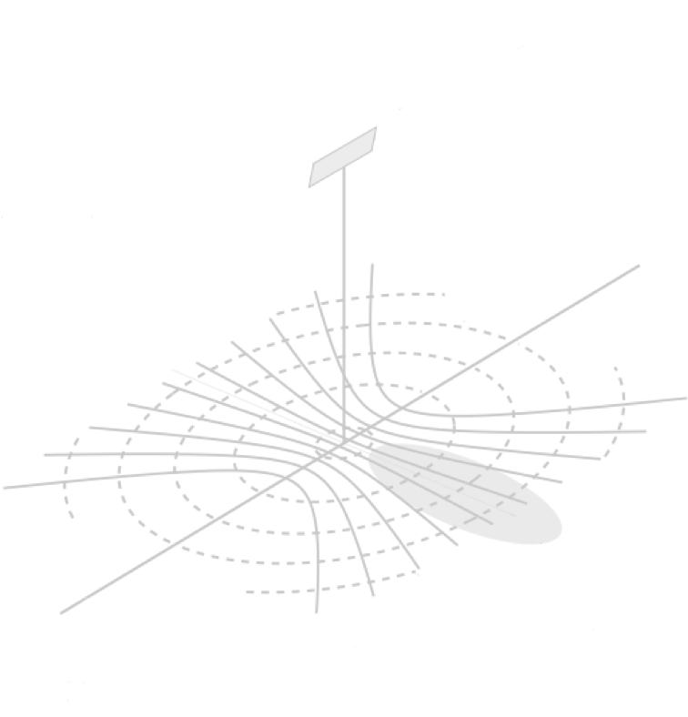
Zero Doppler Processing
Forward Squinted
Backward Squinted
Zero Doppler Illuminated Area
Zero Doppler Processors output the data as though acquired from broadside. This is becoming standard.

Slide 31
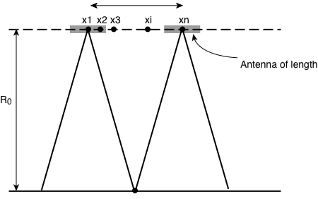
Azimuth Resolution from Aperture Synthesis
Δ X_{az} ∼ λR₀/L_{a}
The illuminated extent of the ground is ΔX_{az} ~λR₀/L_{a}
The synthetic aperture is 2*ΔX_{az} lengthens as R₀ increases…
…which decreases the azimuth synthetic aperture’s angular beamwidth λ/(2*ΔX_{az}) in proportion…
…but the spatial resolution on the ground
(λR₀/ (2*ΔX_{az}) = L_{a}/2
L_{a}/2 is constant

Slide 32
Raw Signal of a Point Target
Range
Pulse Number
This “image” shows a sequence of simulated pulse echoes from a single point target

Slide 33
Range Compression of a Point Target; after Matched filtering
Range
Pulse Number
This “image” shows the simulated pulse echoes after range compression matched filtering

Slide 34
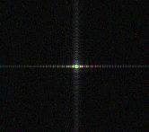
Point Target after Azimuth Compression Matched filtering
Range
Pulse Number
This “image” shows the simulated pulse echoes after range and azimuth compression matched filtering

Slide 35
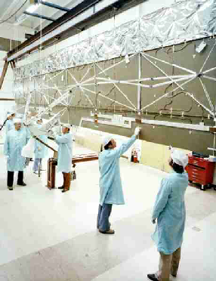
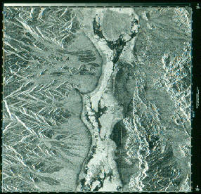
SEASAT – SAR in Space in 1978
SEASAT SAR image of Death Valley (USA) 1978

Slide 36
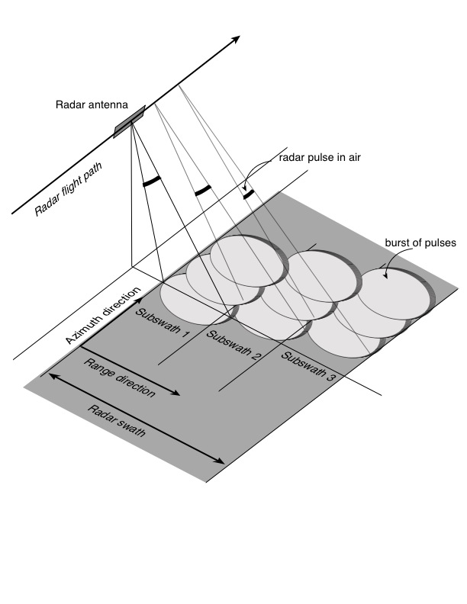
Conventional SAR modes
Strip-mode SAR
Standard SAR mode
Send a pulse of energy; receive echo; repeat
One pulse transmit and receive at a time
Swath width limited by radar ambiguities
ScanSAR
Wider swath low resolution SAR mode
Execute sequence as follows:
Send a pulse of energy; receive echo; repeat 50-100 times
Repoint the beam across-track to position 2 electrically (almost instantaneous)
Send a pulse of energy; receive echo; repeat 50-100 times
Repoint the beam across-track to position 3 electrically (almost instantaneous)
Send a pulse of energy; receive echo; repeat 50-100 times
Again, one pulse transmit and receive at a time
ScanSAR trades resolution (in along-track dimension) for swath: low impact on data rate
Generally poorer ambiguity and radiometric performance than Strip SAR
StripSAR
ScanSAR

Slide 37
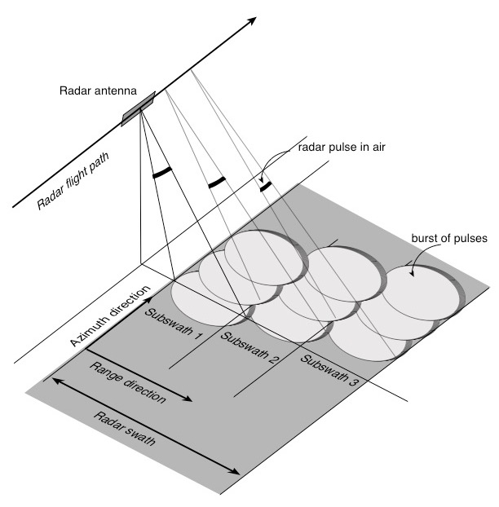
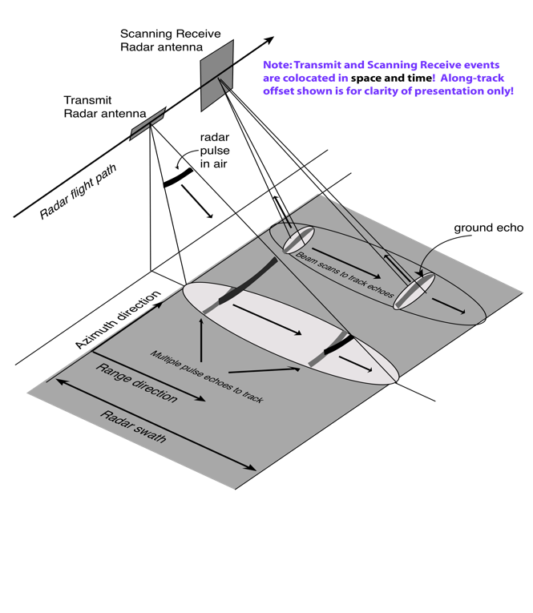
Other Wide Swath SAR Modes
Terrain Observation by Progressive Scan
Scan on Receive SAR (SweepSAR)
Scan beam forward in azimuth during burst
Time-share synthetic aperture among elevation beams to increase swath
Scan beam forward in azimuth within burst to improve radiometry
Degraded azimuth resolution
Time-share pulse returns on receive with multiple receive beams to increase swath
Track receive echoes as they propagate across the swath
Narrow receive beam controls ambiguities

Slide 38
What Radar Can Tell Us
Transmitted radar signals have known characteristics
Amplitude
Polarization
Phase and Time Reference
Wavelength, or Frequency
A distant object that scatters the radar signal back toward the receiver alters the amplitude, polarization, and phase, differently for different wavelengths
Comparison of the received signal characteristics to the transmitted signal allows us to understand the properties of the object.

Slide 39
Surface and Volume Scattering Models for Radar
We can model simple scattering from particles or surfaces…
Cross section of a large sphere is its projected area
Cross section
Cross section of a large flat facet goes as area squared

Slide 40
Surface and Volume Scattering Models for Radar
And we can develop intuition from combinations of these elements…
Random point model
Rayleigh Roughness

Slide 41
Surface and Volume Scattering Models for Radar

Slide 42
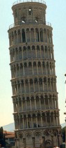



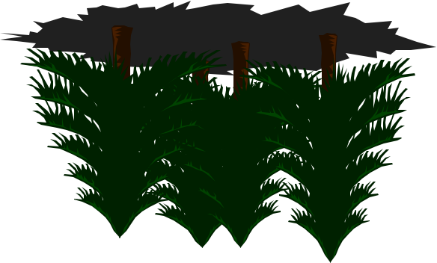

Radar Imaging Properties
• Radar images are distorted
relative to a planimetric view.
Slopes facing toward or away
from the radar appear foreshortened.
Steep slopes are collapsed into a
single range cell called layover and
areas occulted by other areas are
said to be shadowed.
Δρ
Layover
Shadow
Foreshortening
• Radar is primarily sensitive to
the structure of objects being
imaged whereas optical images
are primarily sensitive to
chemistry.
• The scale of objects relative to
the radar wavelength determines
how smooth an object appears
to the radar and how bright or
dark it is in the imagery.
Smooth Surface
Rough Surfaces
Mountains
Forest
Urban
Area

Slide 43
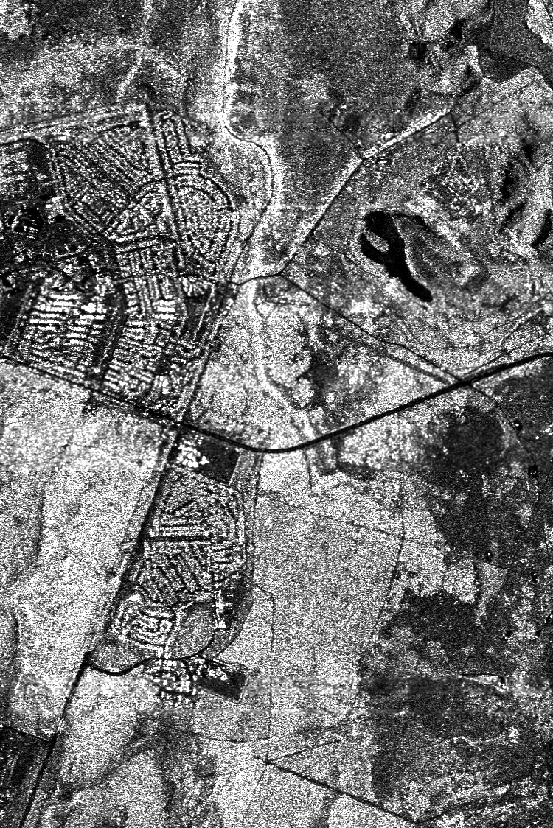
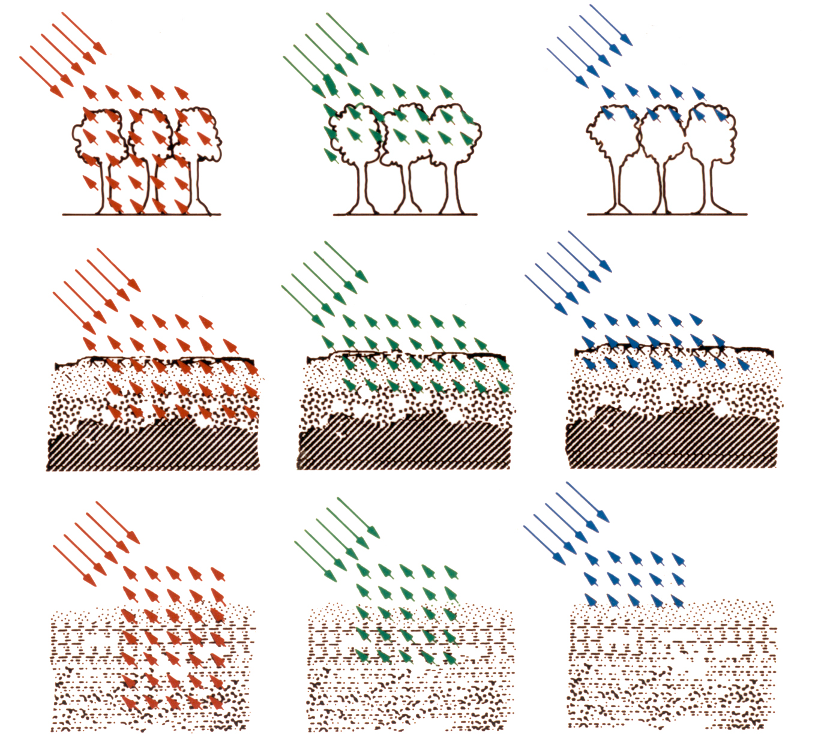
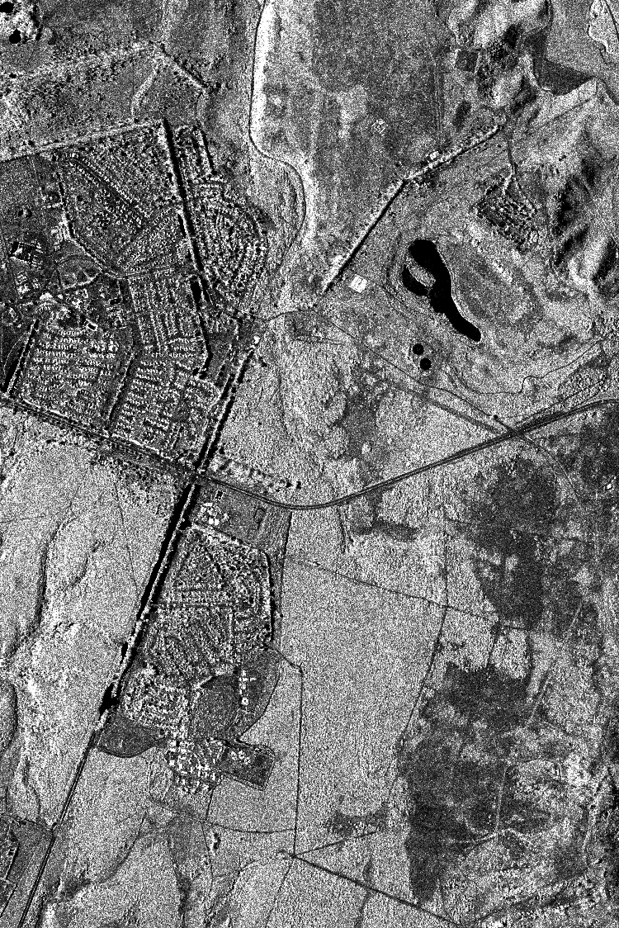
Wavelength - A Measure of Surface Scale
Light interacts most strongly with objects on the size of the wavelength
L (24 cm)
X (3 cm)
C (6 cm)
Forest: Leaves reflect X-band wavelengths but not L-band
Dry soils: Surface looks rough to X-band but not L-band
Ice: Surface and layering look rough to X-band but not L-band

Slide 44
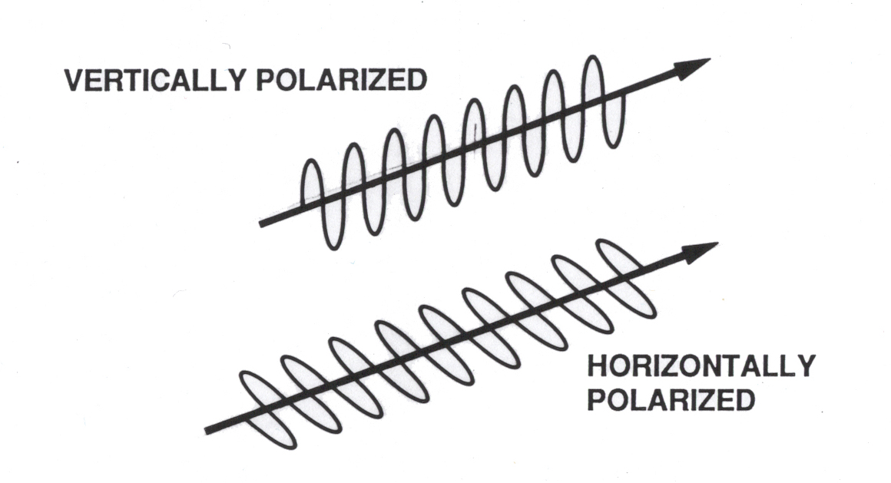
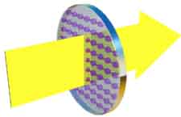




Polarization - A Measure of Surface Orientations and Properties
Wave Polarization
Polarization Filters
Vertical polarization passes through horizontally arranged absorbers.
Horizontal polarization does not pass through horizontally arranged absorbers.
Mostly horizontal polarization is reflected from a flat surface.
Color figures from www.colorado.edu/physics/2000

Slide 45
Radar Equation in Remote Sensing
Backscatter can be used to interpret surface properties
Often using wavelength and polarization to probe characteristics
Other radar instrument characteristics affect the science performance
Wavelength and antenna size determine illuminated area and real-aperture resolution
Antenna size in flight direction determines resolution for a synthetic aperture radar
Antenna area determines ambiguity, or aliasing, performance and swath extent
Sensitivity of the measurement determined by “radar equation”
Signal-to-Noise
Ratio
Transmit Power
Receive Antenna Area
Transmit Antenna Gain
System Efficiency/Losses
Receiver Temperature
Range (distance)
Radar cross-section or “Reflectivity”
Receiver Bandwidth

Slide 46

SAR Imagery and Speckle
Full resolution SAR imagery has a grainy appearance called speckle, which is a phenomena due to the coherent nature of SAR imaging.
The total signal return from a resolution cell is the coherent sum of the returns from all the individual scatterers within it that are generally randomly distributed.
Number and arrangement of scattering elements within resolution cell varies from pixel to pixel.
Phase
Front
Returned signal is a coherent combination of the returns from the scattering elements.
Pixel N
Pixel M

Slide 47


Speckle and Radiometric Accuracy
Natural “laser” speckle masks intrinsic radar backscatter which contains surface information, independent of SNR!
Spatial averaging (looks) reduces the speckle and draws out the natural backscatter reflectivity

Slide 48
Spatial Averaging or Looks
DEM
Pixel
Radar
Pixel
Product Estimation Cell

Slide 49
Outline of Theory Sessions
Morning
I. Radar Imaging Fundamentals
Basic Principles of Radar and SAR
Properties of Radar Images
Afternoon
II. Geometric Aspects of Interferometry and Interferometric Phase
Topographic Mapping
Deformation Mapping
Phase Unwrapping and Atmosphere
III. Interferometric Correlation
SNR and Interferometric Correlation
Geometric, Temporal, Volumetric Decorrelation

Slide 50
What is Radar Interferometry?
Radar interferometry can be broadly defined by use of phase measurements to precisely measure the relative distance to an object when imaged by synthetic aperture radar from two or more observations separated either in time or space.
Interferometric phase is simply another means of measuring (relative) distance.
Δρ
2π
4π
• Phase measurements in interferometric
systems can be made with degree level
accuracy, and with typical radar
wavelengths in 3-80 cm range
this corresponds to relative range
measurements having millimeter
accuracy.
1 λ
2 λ

Slide 51

Interference Concept
Interference occurs when the phase of two different waves is not aligned. The observed intensity, I, is the time average of the sum of the wave fields
Intermediate phase alignment
E(z,t)=E₀ cos(2π(f t - z / λ))
E₁
I
E₂
Phase aligned waves add constructively
Phase opposed waves add destructively

Slide 52


Young’s Interferometer
In Young’s experiment, a point source illuminates two separated vertical slits in an opaque screen. The slits are very narrow and act as line sources. For this case, the pattern of intensity variations on the observing screen is bright/dark banding.
(Born and Wolf, 1980)
Observing Screen
Screen laid flat

Slide 53

Wave Interference

Slide 54

Young’s Interferometer with a phase detector
If the relative phase of the signals could be observed on the screen, it could be represented

Slide 55

Radar Interferometry
Radar Interferometry is a simple extension of the Young’s interferometry concept
Radar has a coherent source much like a laser
The two radar (SAR) antennas act as coherent point sources
SAR images are acquired independently, and act as amplitude and phase detector of the surface
Two SAR images can be combined to observe the interference pattern of the surface.

Slide 56


Radar Interferometry Example
Standard Radar Image
“Interferogram”
An “interferogram” is a complex image:
Its magnitude is related to correlation
Its phase is related to geometry differences
One cycle of color represents one cycle of relative phase
Once cycle of relative phase represents 1/p wavelengths of path difference, p=1 or 2

Slide 57
Types of Radar Interferometry
Two main classes of interferometric radars are separated based on the geometric configuration of the baseline vector, i.e. the vector separating the antenna locations in the interferometric pair. These are:
Interferometers are used for topographic measurements when the antennas are separated in the cross-track direction.
Interferometers are used to measure line-of-sight motion when the antennas are separated in the along-track direction.
A single antenna repeating its path can form an interferometer to measure long-term deformation
Cross-Track Interferometer
Along-Track Interferometer
Flight Tracks
Radial
Motion
• Dual antenna single pass interferometers
• Single antenna repeat pass interferometers
==> Topography and Deformation
• Dual antenna single pass interferometer
• Along-track separation
==> Radial velocity

Slide 58
Interferometry Applications
Mapping/Cartography
Radar Interferometry from airborne platforms is routinely used to produce topographic maps as digital elevation models (DEMs).
Shuttle Radar Topography Mission produced near-global 30 m DEM in 2000
Tandem-X soon to produce global 12 m DEM
Radar imagery is automatically geocoded, easily combined with other (multispectral) data sets.
Applications of topography enabled by interferometric rapid mapping
Land use management, classification, hazard assessment, intelligence, urban planning, short and long time scale geology, hydrology
Deformation Mapping and Change Detection
Repeat Pass Radar Interferometry from spaceborne platforms is routinely used to produce topographic change maps as digital displacement models (DDMs).
Sub-centimeter relative displacement accuracy
10-100 m post spacing and resolution
100 km by 100 km DDMs produced rapidly once data is available
Applications include
Earthquake and volcano monitoring and modeling, landslides and subsidence
Glacier and ice sheet dynamics
Deforestation, change detection, disaster monitoring

Slide 59
Interferometry for Topography
Measured phase difference:
Δ
Triangulation:
Critical Interferometer Knowledge:
- Baseline, ,to mm’s
- System phase differences, to deg’s

Slide 60

Data Collection Options
For single pass interferometry (SPI) both antennas are located on the same platform. Two modes of data collection are common:
single-antenna-transmit mode - one antenna transmits and both receive
ping-pong mode - each antenna transmits and receives its own echoes effectively doubling the physical baseline.
Classic
Ping-Pong
Δ
Δ

Slide 61
Height Reconstruction
Interferometric height reconstruction is the determination of a target’s position vector from known platform ephemeris information, baseline information, and the interferometric phase.
platform position vector
range to target
unit vector pointing from platform to target
target location vector
BASIC EQUATION
• Interferometry provides a means of determining

Slide 62
Interferometric Geometry
Δ
α
θ
,
• p equals 1 or 2 depending on system

Slide 63
2-D Height Reconstruction - Flat Earth
.
Assume that b << ρ and let
Taking a first order
Taylor’s expansion of
Δ
φ
the interferometric phase can be approximated as
Δ
With = (bcos(α),bsin(α)) and = (sin(θ),-cos(θ)) then
Δ

Slide 64
2-D Height Reconstruction - Flat Earth II
Let = (y_{o} , h) be the platform position vector, then
θ
ρ
• Solving for θ in terms of the
interferometric phase, Δφ, yields
h
y_{o}

Slide 65
Phase Gradient
• For a number of applications including flight planning and unwrapping studies it is desirable to be able to compute the interferometric phase gradient for an arbitrarily sloped surface, look geometry and baseline.
• The interferometric phase is well approximated for most applications by
(φ ⬄ Δφ)
where is the baseline vector, a unit vector pointing to the target and λ is the wavelength.
• The phase gradient is
where s is the along track coordinate and ρ is the range.

Slide 66

Phase Gradient Observations
There in a change in phase with respect to range regardless of whether the terrain is sloped in the range direction or not. The phase rate, or fringe rate, with respect to a flat surface is called the flat surface (or spherical earth) fringe frequency.
Note that the fringe rate depends on the local slope and the perpendicular baseline length.
The fringe rate in the azimuth or along track direction is zero unless there is an azimuth slope. It also depends on the magnitude of the local slope and the perpendicular baseline length
(φ ⬄ Δφ)

Slide 67


Flattened Phase
• In creating an image, ISCE performs a “motion compensation” step, recalculating positions and phases as though from a reference orbit. This step removes the flat earth fringes the resulting fringes will follow the local topography, the so-called “flattened” phase.
• The flattened phase is given by
where is the look vector to a point and is the corresponding look vector to the flat surface at the same range.
• Making the usual 2 dimensional simplifications
Δ
Δ

Slide 68


Flattened Phase II
b
ρ+δρ
θ_{ο}
Δ
δθ
ρ
ρ
h_{T}
θ_{ο}
From the figure we have
which gives
Δ
Thus the topographic portion of the interferometric phase is a function of the perpendicular baseline length.

Slide 69

Sensitivity of Height with Respect to Phase
Sensitivity to Phase
Ambiguity Height
(φ ⬄ Δφ)
p=1,2
• Observe that is parallel to .

Slide 70
Data Collection Options II
Interferometric data can also be collected in the repeat pass mode (RPI). In this mode two spatially close radar observations of the same scene are made separated in time. The time interval may range from seconds to years. The two observations may be made different sensors provided they have nearly identical radar system parameters.
Second observation made at some later time.
Δ

Slide 71

Differential Interferometry
When two observations are made from the same location in space but at different times, the interferometric phase is proportional to any change in the range of a surface feature directly.

Slide 72



Differential Interferometric Phase
Δ
α
θ
Δ
Assuming that
yields
,
Δ

Slide 73



Differential Interferometry and Topography
• Generally two observations are made from different locations in space and at different times, so the interferometric phase is proportional to topography and topographic change.
Δ
Topography
Term
Change
Term
Δ
Δ
Δ
Note: Sensitivity of phase with respect to change is much greater than with respect to topographic relief
If topography is known, then second term can be eliminated to reveal surface change

Slide 74





Extracting the Deformation Term - Pre-Existing DEM
Δ
Phase Simulated from DEM
Using Unflattened Phases
Using Flattened Phases

Slide 75




Extracting the Deformation - Three Passes
Δ
Change Pair
Δ
Topo Pair
Using Unflattened Phases
Δ
Δ
Δ
Δ
Using Flattened Phases

Slide 76






Differential Interferometry Sensitivities
• The reason differential interferometry can detect millimeter level surface deformation is that the differential phase is much more sensitive to displacements than to topography.
Topographic Sensitivity
(φ ⬄ Δφ)
Displacement Sensitivity
Topographic Sensitivity Term
Displacement Sensitivity Term
Since
==>
Meter Scale Topography Measurement - Millimeter Scale Topographic Change

Slide 77



Some Examples of Deformation
Hector Mine
Earthquake
Etna Volcano
Ice Velocities
Joughin et al , 1999

Slide 78
Phase Unwrapping
From the measured, wrapped phase, unwrap the phase from some arbitrary starting location, then determine the proper 2π phase “ambiguity”.
Actual phase
Wrapped (measured) phase
Typical unwrapped phase

Slide 79
Phase Unwrapping Algorithm Options
There are a number of approaches to unwrapping:
Residue –or branch cut– methods that use a simple mechanism to detect where phase consistencies in the phase field exist and generate cuts to avoid them
Least squares methods that pose the unwrapping problem as an estimation problem and try to efficiently solve the resulting series of equations. (mostly obsolete)
Minimum cost flow algorithms that pose the unwrapping problem as a network flow problem for which algorithms have been developed over the years
ISCE supports two residue methods and a version of minimum cost flow developed at Stanford (SNAPHU)

Slide 80
Real World Phase Behavior
Benign topography resulting in a monotonous and well-behaving phase
Rough topography leading to lay-over and shadows and a generically non-monotonous and non-continuous phase

Slide 81

Two-Dimensional Phase Unwrapping
Two dimensional phase field values below are in units of cycles
One-dimensional unwrapping criterion of half-cycle proximity is inconsistent in two dimensions
Residues, marked with + and -, define ambiguous boundaries.

Slide 82
Residues in Phase Unwrapping
The wrapping operator delivers the true phase modulo 2 π, in the interval -π < φ < π.
The true phase gradient is conservative:
The wrapped gradient of the measured, wrapped phase, however, may not be conservative:
When this function is non-conservative, its integration becomes path dependent.
Residues occur at locations of high phase noise and/or phase shear such that the wrapped gradient of the measured, wrapped phase is no longer conservative.

Slide 83
Branch Cuts in Phase Unwrapping
Branch-cut algorithms (Goldstein, Zebker, and Werner 1986) seek to neutralize these regions of inconsistency by connecting residues of opposite solenoidal sense with cuts, across which integration may not take place.
Branch cut connections force path independence in the integration of the wrapped phase gradient.
If done properly, the integrated phase field will be correct. But which is correct?

Slide 84

Illustration of Branch Cut Algorithm
Connect all simple
pairs
Expand search window
and connect where
possible
Could not connect
last residue with this
search window size
Initiate search from
every residue
encountered
Repeat all steps with
larger search window size

Slide 85
Branch Cut Strategies
The standard GZW algorithm is designed to connect residues into a neutral network into the shortest possible connection tree, i.e. to minimize the length of the individual branch cuts comprising a tree
This will not necessarily create the shortest possible tree, since GZW makes many unnecessary connections in its search for neutrality
Various criteria have been devised to place guiding centers (unsigned residues) along expected paths to facilitate the right choice in branch cut connection
Residues
Guiding Centers

Slide 86
Guiding Center Criteria
A number of criteria have been devised for selecting guiding centers, each more or less tailored to characteristics of SAR data:
when phase slope exceeds threshold (implies layover)
when derivative of phase slope exceeds threshold
when radar brightness exceeds threshold (implies layover)
when decorrelation estimator exceeds threshold (implies noise and/or layover
Some guiding center selections help in some cases
Difficult to assess performance in a quantitative way

Slide 87
Connected Components
Connected component is a term borrowed from topology that denotes a set of points in a patch such that any two points in the set can be connected by a continuous path that does not cross a branch cut or a mask or patch boundary.
Connected components arise during the unwrapping process when the trees or noise mask separate the patch into multiple regions.
An example of this would be a river running down the middle of the patch with low correlation, hence noisy phase, in the river, effectively bissecting the phase into two distinct regions.

Slide 88
Absolute Phase Determination
Actual phase
Wrapped (measured) phase
Typical unwrapped phase
Ground control reference points can be used to determine the absolute phase ambiguity

Slide 89


Tropospheric Effects on InSAR
Pass 2
Pass 1
Simulated phase artifacts due to differential tropospheric delay between two passes
SAR
Signal Path
Troposphere
Ground Surface
Tropospheric path delays cause artifacts in repeat-pass interferometric synthetic aperture radar (InSAR) measurements of surface displacement
Rapidly varying tropospheric delays (both spatially and temporally) are most problematic
Such variations are primarily due to changes in water vapor content along signal propagation path

Slide 90
Effects on InSAR Phase
SAR
Flight Path
Signal Propagation Path
Troposphere
Ground Target
Observed InSAR phase for broadside acquisition:
Have two unknown parameters (δ_{atm}, δ_{LOS}), but only one equation
Tropospheric delays δ_{atm} are indistinguishable from line-of-sight (LOS) surface displacements δ_{LOS}

Slide 91

Hawaii SIR-C One Day Repeat Pass Data Showing Tropospheric Distortion
0 Relative Phase 2π
DAYS 7-8 TWO-PASS DAYS 7-10 TWO-PASS DAYS 7-8-10 THREE-PASS

Slide 92




Landslide Motion Detection
Creeping landslides detected in 31 and 80 day repeat pass interferograms
The amount of deformation increased for the larger pair with the larger temporal baseline indicating continued creep from May to July
31 Day Repeat
LOS Displacement (m)
80 Day Repeat
Cut A 31 Day
Cut A 80 Day
Cut B 31 Day
Cut B 80 Day
Cut C 31 Day
Cut C 80 Day

Slide 93

Basic Interferometric Flow
(ISCE does not have baseline re-estimation capability)
93

Slide 94
Interferometric Error Sources
Interferometric decorrelation
Propagation delay errors from atmosphere and ionosphere
Phase unwrapping errors
Range and azimuth ambiguities due to design constraints
Layover and shadow in radar imagery from slant range geometry
Multiple scattering within and among resolution cells
Range and azimuth sidelobes due to bandwidth/resolution constraints
Multipath and channel cross-talk noise as low-level interference
Calibration errors

Slide 95
Radar Coherent Backscatter
Pixels in a radar image are a complex phasor representation of the coherent backscatter from the resolution element on the ground and the propagation phase delay

Slide 96
Interferometric Phase Characteristics
Pixels in two radar images observed from nearby vantage points have nearly the same complex phasor representation of the coherent backscatter from a resolution element on the ground but a different propagation phase delay

Slide 97
Correlation* Theory
Signals decorrelate due to
Thermal and Processor Noise
Differential Geometric and Volumetric Scattering
Rotation of Viewing Geometry
Random Motions Over Time
Decorrelation relates to the phase standard deviation of the interferogram
Affects height and displacement accuracy
Affects ability to unwrap phase
*“Correlation” and “Coherence” are often used synonymously

Slide 98
Correlation Definition
Deterministic signals
or combinations have
perfect correlation
Signals with random
components have
imperfect correlation

Slide 99
Expectation Estimator
Expectation over the ensemble of realizations and cannot
be calculated from a specific realization, that is, the observations
and . In general, an estimator derived from the image data
must be devised.
The maximum likelihood estimator (MLE) of the interferometric phase
difference between images forming an interferogram that have homo-
geneous backscatter and constant phase difference is
where l and m are image indices relative to some reference location and the sum is computed over a N x M box. N and M are known as the number of looks in their respective image dimensions.

Slide 100
Correlation Estimator
The standard estimator of the interferometric correlation between
images forming an interferogram that have homogeneous backscatter
and constant phase difference is
This estimator is biased. As an example, consider N = 1, M = 1. Then
where x and y are the coordinates of a particular image pixel. Other
biases arise when backscatter homogeneity and phase constancy are
violated.

Slide 101

Correlation Estimator Characteristics
A general set of curves of reveals the nature of the estimator bias
when backscatter is homogeneous and phase is constant.

Slide 102

Relationship of Phase Noise and Decorrelation
Increased decorrelation is associated with an increase in the interferometric phase noise variance
If averaging N > 4 samples, the phase standard deviation approaches the Cramer-Rao bound on the phase estimator:
Phase noise contributes
to height errors in inter-
ferometry as demonstrated
in the sensitivity equations

Slide 103
Thermal Noise Decorrelation
Radar receiver electronics will add thermally generated noise to
the image observations.
The added noise contributes randomly to the interferometric phase
from pixel to pixel, causing thermal noise decorrelation. Assuming
uncorrelated noise, the correlation between and is

Slide 104
Thermal Noise Decorrelation
The correlation is related in a simple way to the reciprocal of the
Signal-to-Noise Ratio (SNR). For observations with identical
backscatter and equal noise power,
Decorrelation is defined as
The decorrelation due to thermal noise can vary greatly in a scene,
not from thermal noise variations, but from variations in backscatter
brightness. Extreme cases are:
Radar shadow, where no signal is returns; correlation is zero.
Bright specular target, where signal dominates return; correlation is 1

Slide 105

Baseline Decorrelation
Pixels in two radar images observed from nearby vantage points have nearly the same complex phasor representation of the coherent backscatter from a resolution element on the ground

Slide 106







Form of Baseline Correlation Function
If W(x,y) is assumed to be a sinc function, then the integral can be done in closed form (for ping-pong mode)
A₁
B
A₂
ρ
Δθ
For B>>ρ,
Δθ ∼ / ρ
This function goes to zero at the
critical baseline

Slide 107



The “Pixel Antenna” View of Baseline Decorrelation
v
Each resolution element can be con-
sidered a radiating antenna with beam-
width of , which depends on the
range and local angle of incidence.
Radar
Sensor
θ
θ
ρ
n
n=1,2
Image Pixel/
Resolution Element
When the two apertures of the
interferometer are within this
beamwidth, coherence is main-
tained. Beyond this critical
baseline separation, there is no
coherence for distributed targets
θ
Image Pixel/
Resolution Element

Slide 108


Overcoming Baseline Decorrelation
Δρ
Effective
Projected Resolution
Distributed targets correlate over a narrow range of baselines
Urban Corner Reflectors
Δρ
JPL Corner Reflector
Effective Range Resolution
Corner Reflector
Pixels dominated by single scatterers generally behave though imaged at much finer resolution

Slide 109
Critical Baseline
The critical baseline is the aperture separation perpendicular to the look direction at which the interferometric correlation becomes zero.
n=1,2
Interferometers with longer wavelengths and finer resolution are less sensitive to baseline decorrelation. When the critical baseline is reached, the interferometric phase varies as
The relative phase of scatterers across a resolution element
changes by a full cycle, leading to destructive coherent summation

Slide 110

Rotational Decorrelation
Rotation of scatterers in a resolution element can be thought of as
observing from a slightly different azimuthal vantage point. As with
baseline decorrelation, the change in differential path delay from
individual scatterers to the reference plane produces rotational
decorrelation.

Slide 111



Form of Rotational Correlation Function
A similar Fourier Transform relation as found in the baseline decorrelation formulation exists
where R_{x} is the azimuth resolution
and B_{φ} is the distance along track corresponding to the rotation angle of the look vector
This function goes to zero at the
critical rotational baseline

Slide 112
Scatterer Motion
Motion of scatterers within the resolution cell from one observation
to the next will lead to randomly different coherent backscatter
phase from one image to another, i.e. “temporal” decorrelation.

Slide 113


Form of Motion Correlation Function
The Fourier Transform relation can be evaluated if Gaussian probability distributions for the motions are assumed
where σ_{y,z} is the standard deviation of the scatterer displacements cross-track and vertically
Note correlation goes to 50% at about 1/4 wavelength displacements

Slide 114


Repeat-pass Interferometry and Coherent Change Detection L-Band low frequency improves correlation in vegetated areas
Most radars do well in areas of sparse vegetation
But maintaining correlation in dense vegetation requires longer wavelengths
Loss of correlation is due to:
volume of vegetation
movement of vegetation
dielectric change (moisture)
Correlation
P- L- C- X-
Frequency band
Effective phase center
VHF
L-band
UHF
C-band
P-band
X-band

Slide 115


Coherent Change Detection SIR-C L and C-band Interferometry
6 month time separated observations to form interferograms
Simultaneous C and L band
InSAR experiments have shown good correlation at L-band

Slide 116






AIRSAR Coherent Change Detection
Interferograms
C-band
L-band
P-band
Correlation
Airborne InSAR experiments have shown good correlation at L-band

Slide 117


A Correlation Test: What were the interferometric observation conditions?

Slide 118
Other Resources
M. Simons and P. Rosen,
Interferometric Synthetic Aperture Radar Geodesy
Treatise on Geophysics, Schubert, G. (ed.), Volume 3- Geodesy, Elsevier Press, pp. 391-446, 2007
http://www.gps.caltech.edu/~simons/pdfs/Simons_Treatise.pdf
Rosen, P. A.; Hensley, S.; Joughin, I. R.; Li, F. K.; Madsen, S. N.; Rodriquez, E. & Goldstein, R. M.
Synthetic Aperture Radar Interferometry
Proc. IEEE, 2000, 88, 333-382
Burgmann, R.; Rosen, P. & Fielding, E.
Synthetic Aperture Radar Interferometry to measure Earth's surface topography and its deformation
Ann.~Rev.~Earth Planet.~Sci., 2000, 28, 169-209
Madsen, S. N. & Zebker, H. A.
Synthetic Aperture Radar Interferometry: Principles and Applications
Manual of Remote Sensing, Artech House, 1999, 3
Massonnet, D. & Feigl, K. L.
Radar interferometry and its application to changes in the earth's surface
Reviews of Geophysics, 1998, 36, 441-500
Bamler, R. & Hartl, P.
Synthetic Aperture Radar Interferometry
Inverse Problems, 1998, 14, 1-54
Richards, J.A.
Remote Sensing with Imaging Radar, 2009, Springer.
118

